Slide 1
Basic Concepts of Big Data (20 Hours)
• Session 1-4:
o Concept and characteristics of Big Data
o History of Big Data
o Jobs in Big Data
o Types of Big data (structured, semi-structured, unstructured)
• Session 5-9:
o Big Data Frameworks
o Big Data Programming Paradigms
o Big Data Programming Languages
• Session 10-11:
o Introduction to Data Science and Skillset required for working with Big Data
• Session 12-15:
o Simplified Overview of Machine Learning Algorithms and Neural Networks
o Types of Machine Learning (Supervised, Un-Supervised, Reinforcement)
• Session 16-18:
ACTS, Head Quarters, Pune
o Examples of Big Data and Data Science in Practice (Healthcare, Logistics & Transportation,
Manufacturing etc.
• Session 19-20:
o Application Examples and Real –World Use Cases (e.g., Healthcare, finance, marketing, etc.)

Slide 2
Types of Big Data Technologies (+ Management Tools)
1. Data storage
3. Data analytics
Apache Hadoop
Apache Spark
Apache Spark
Splunk
Apache Hive
KNIME
Apache Flume
ElasticSearch
MongoDB
4. Data visualization
2. Data mining
Tableau
Rapidminer
Power BI
Presto

Slide 3
pros:
1. Multiple deployment options based on our preference.
2. Strong visualization.
3. Accurate Preprocessing.
4. Multiple interfaces.
5. Java API available that can be used in programs.
cons:
1. It takes too much memory and so slows down your system.
2. Less forums for support.
Rapidminer
Apache Hadoop
The Apache Hadoop software library is a framework that allows for the distributed processing of large data sets across clusters of computers using simple programming models. It is designed to scale up from single servers to thousands of machines, each offering local computation and storage.
MongoDB
MongoDB is a source-available cross-platform document-oriented database program.
Classified as a NoSQL database program, MongoDB uses JSON-like documents with optional schemas
Presto
A single Presto query can process data from multiple sources like HDFS, MySQL, Cassandra, Hive and many more data sources. Presto is built in Java and easy to integrate with other data infrastructure components. Presto is powerful, and leading companies like Airbnb, DropBox, Groupon, Netflix are adopting it.

Slide 4
Apache Spark
Apache Spark is an open-source unified analytics engine for large-scale data processing. Spark provides an interface for programming clusters with implicit data parallelism and fault tolerance
Splunk
Splunk is a program that enables the search and analysis of computer data. It analyzes semi-structured data and logs generated by various processes with proper data modeling as per the need of the IT companies. The user produces the data by means of any device like- web apps, sensors, or computers. It has built-in functionality for defining data types, field separators, and search process optimization. For the searched result, it also provides visualization of data.
Tableau can handle huge columns of data and still offer better performance. | Power BI is best for a limited volume of data.
Tableau has better data visualization. | Power BI offers many data points for data visualization.
Tableau works best with huge data. | Power BI is suboptimal with huge data.
Experts and experienced users use Tableau. | Power BI is used by beginners and experienced alike.

Slide 5
8. HPCC Systems
1. Airflow
9. Hudi
10. Iceberg
2. Delta Lake
19. MongoDB
3. Drill
11. Kafka
4. Druid
18. Trino
5. Flink
12. Kylin
17. Storm
6. Hadoop
13. Pinot
7. Hive
16. Spark
14. Presto
15. Samza

Slide 6
1. Data storage
Apache Hadoop
Hortonworks
Data lake
Apache Spark
MongoDB
Apache Cassandra
P r e s t o
Cloudera
Cloud storage
Elastic search
Hybrid storage

Slide 7
Cloud Service Providers
Microsoft Azure
Google Cloud Platform
Amazon Web Service (AWS)
Oracle Cloud
IBM Cloud Services
Rackspace
Adobe Creative Cloud
Red Hat
SAP
Kamatera
Salesforce
Verizon Cloud
VMware

Slide 8
1. Airflow
Airflow in Apache is a popularly used tool to manage the automation of tasks and their workflows. They are also primarily used for scheduling various tasks. Consider that you are working as a data engineer or an analyst and we might need to continuously repeat a task that needs the same effort and time every time. The kind of such tasks might consist of extracting, loading, or transforming data that need a regular analytical report. We can simply automate such tasks using Airflow in Apache by training your machine learning model to serve these kinds of tasks on a regular interval specified while training it
2. Delta Lake

Slide 9
What is Big Data
Data which are very large in size is called Big Data. Normally we work on data of size MB(WordDoc ,Excel) or maximum GB(Movies, Codes) but data in Peta bytes i.e. 10^15 byte size is called Big Data. It is stated that almost 90% of today's data has been generated in the past 3 years.
Sources of Big Data
These data come from many sources like
Social networking sites: Facebook, Google, LinkedIn all these sites generates huge amount of data on a day to day basis as they have billions of users worldwide.
E-commerce site: Sites like Amazon, Flipkart, Alibaba generates huge amount of logs from which users buying trends can be traced.
Weather Station: All the weather station and satellite gives very huge data which are stored and manipulated to forecast weather.
Telecom company: Telecom giants like Airtel, Vodafone study the user trends and accordingly publish their plans and for this they store the data of its million users.
Share Market: Stock exchange across the world generates huge amount of data through its daily transaction.

Slide 10
3V's of Big Data
Velocity: The data is increasing at a very fast rate. It is estimated that the volume of data will double in every 2 years.
Variety: Now a days data are not stored in rows and column. Data is structured as well as unstructured. Log file, CCTV footage is unstructured data. Data which can be saved in tables are structured data like the transaction data of the bank.
Volume: The amount of data which we deal with is of very large size of Peta bytes.
Use case
An e-commerce site XYZ (having 100 million users) wants to offer a gift voucher of 100$ to its top 10 customers who have spent the most in the previous year.Moreover, they want to find the buying trend of these customers so that company can suggest more items related to them.

Slide 11
Issues
Huge amount of unstructured data which needs to be stored, processed and analyzed.
Solution
Storage: This huge amount of data, Hadoop uses HDFS (Hadoop Distributed File System) which uses commodity hardware to form clusters and store data in a distributed fashion. It works on Write once, read many times principle.
Processing: Map Reduce paradigm is applied to data distributed over network to find the required output.
Analyze: Pig, Hive can be used to analyze the data.
Cost: Hadoop is open source so the cost is no more an issue.

Slide 12
What is Hadoop
Hadoop is an open source framework from Apache and is used to store process and analyze data which are very huge in volume. Hadoop is written in Java and is not OLAP (online analytical processing). It is used for batch/offline processing.It is being used by Facebook, Yahoo, Google, Twitter, LinkedIn and many more. Moreover it can be scaled up just by adding nodes in the cluster.
Modules of Hadoop
HDFS: Hadoop Distributed File System. Google published its paper GFS and on the basis of that HDFS was developed. It states that the files will be broken into blocks and stored in nodes over the distributed architecture.
Yarn: Yet another Resource Negotiator is used for job scheduling and manage the cluster.
Map Reduce: This is a framework which helps Java programs to do the parallel computation on data using key value pair. The Map task takes input data and converts it into a data set which can be computed in Key value pair. The output of Map task is consumed by reduce task and then the out of reducer gives the desired result.
Hadoop Common: These Java libraries are used to start Hadoop and are used by other Hadoop modules.

Slide 13
Hadoop Architecture
The Hadoop architecture is a package of the file system, MapReduce engine and the HDFS (Hadoop Distributed File System). The MapReduce engine can be MapReduce/MR1 or YARN/MR2.
A Hadoop cluster consists of a single master and multiple slave nodes. The master node includes Job Tracker, Task Tracker, NameNode, and DataNode whereas the slave node includes DataNode and TaskTracker.

Slide 14
Using Big Data Analytics Tools
Healthcare: Big data analytics technologies and tools are being used in healthcare to predict patient outcomes, identify at-risk patients, and improve population health.
Retail: Big data analytics tools are being used by retailers to improve customer experience, target marketing campaigns, and prevent fraud.
Manufacturing: Big data analytics tools are being used in manufacturing to improve quality control, reduce downtime, and optimize production processes.
Banking: Real time big data analytics tools are being used by banks to detect fraudulent activities, prevent money laundering, and improve customer service.
Government: Big data analytics tools are being used by government agencies to improve public services, combat fraud and corruption, and better understand citizen needs.
Limitations of Big Data Analytics Tools
There are several limitations to big data analytics tools, including:
They can be expensive and require a lot of resources to implement.
They can be complex to use and require skilled staff to get the most out of them.
They can require a lot of data to be effective, which can be a challenge to collect.
They can be slow and may not be able to keep up with rapidly changing data.
They can produce biased results, depending on how they are configured.

Slide 15
Best tool for big data analytics?
Big Data frameworks such as Apache Hadoop are widely used in the market. Clusters of computers can be used to process massive data sets using Hadoop. Scaling up from one server to tens of thousands of commodity computers is one of the best features of this Big Data Tool.
Five types of big data analytics?
The five types of big data analytics are as follows:
Cyber Analytics
Prescriptive Analytics
Descriptive Analytics
Diagnostic Analytics
Predictive Analytics

Slide 16
Data engineering
Data engineering is the process of building robust data architecture that allows for data processing. This includes data transfers between databases and building data warehouses for easy accessibility.
Through data engineering, the following question is answered: “How do I make all the data we collect easier for our data analysts and other stakeholders to wade through?” Data engineering makes the data more reliable, accurate, and ingestible through robust data processing systems.

Slide 17
Data Engineer and a Data Analyst?

Slide 18
Data Engineering

Slide 19
Requirements To Become a Data Engineer
Requirements To Become a Data Analyst

Slide 20
Data Analyst, Data Engineer and Data Scientist

Slide 21
1. Data in ____ bytes size is called Big Data.
Tera
Giga
Peta
Meta
4. In Big Data environments, Velocity refers –
Data can arrive at fast speed
Enormous datasets can accumulate within very short periods of time
Velocity of data translates into the amount of time it takes for the data to be processed
All of the mentioned above
2. How many V's of Big Data?
2
3
4
5
Answer: D) 5
Volume, Velocity, Variety, Value and Veracity
5. In Big Data environments, Variety of data includes –
Includes multiple formats and types of data
Includes structured data in the form of financial transactions,
Includes semi-structured data in the form of emails and unstructured data in the form of images
All of the mentioned above
3. Unprocessed data or processed data are observations or measurements that can be expressed as text, numbers, or other types of media.
True
False
6. Which of the following are Benefits of Big Data Processing?
Cost Reduction
Time Reductions
Smarter Business Decisions
All of the mentioned above

Slide 22
7. Data that does not conform to a data model or data schema is known as ______.
Structured data
Unstructured data
Semi-structured data
All of the mentioned above
10 Amongst which of the following can be considered as the main source of unstructured data.
Twitter
Facebook
Webpages
All of the mentioned above
8. Amongst which of the following is/are not Big Data Technologies?
Apache Hadoop
Apache Spark
Apache Kafka
Apache Pytarch
11. Amongst which of the following shows an example of unstructured data,
Students roll number, age
Videos
Audio files
Both B and C
9.______ involves the simultaneous execution of multiple sub-tasks that
collectively comprise a larger task.
Parallel data processing
Single channel processing
Multi data processing
None of the mentioned above
12 Scalability, elasticity, resource pooling, self-service, low cost and fault tolerance are the features of,
Cloud computing
Power BI
System development
None of the mentioned above

Slide 23
Big data is a field that treats ways to analyze and systematically extract information from or otherwise deal with data sets. Data can be large or complex to be dealt with by traditional data processing applications software
A large amount of data
It is a popular term used to express the exponential growth of data.
Big data is difficult to store, collect, maintain, analyze and visualize.
Distributed file system: A distributed file system is a file system in which data is stored on a server. The data is accessed and processed as if it were stored on the local client machine. The following are the Characteristics of distributed file system:
Transparency
user mobility
Performance
simplicity and ease of use
Scalability
high availability
high reliability
Big data tools: Apache Hadoop, Apache Storm, Cassandra, Mongo DB, Neo4j. Learn More.

Slide 24
Big data sources:
Amazon, Redshift, Mongo DB
Challenges of big data:
Uncertainty of data management
The talent gap in big data
Getting data into a big data structure
Synchronizing across data sources
Integration
Benefits of big data:
Cost
Time reduction
Speeding up decision-making
Analyze in real-time
Model and Test variation
Characteristics of big data:
Volume
Velocity
Variety

Slide 25
Types of big data:
Structured
unstructured
Semi-structured
hybrid
Use cases of big data:
Recommendation engine
Analyzing call detail records
Fraud detection
sentiment analysis

Slide 26
What is Structured Data?
Structured data is information that has been formatted and transformed into a well-defined data model. The raw data is mapped into predesigned fields that can then be extracted and read through SQL easily. SQL relational databases, consisting of tables with rows and columns, are the perfect example of structured data.
The relational model of this data format utilizes memory since it minimizes data redundancy. However, this also means that structured data is more inter-dependent and less flexible. Now let’s look at more examples of structured data.
Examples of Structured Data
This type of data is generated by both humans and machines. There are numerous examples of structured data from machines, such as POS data like quantity, barcodes, and weblog statistics. Similarly, anyone who works on data would have used spreadsheets once in their lifetime, which is a classic case of structured data generated by humans. Due to the organization of structured data, it is easier to analyze than both semi-structured and unstructured data.

Slide 27
What is Semi-Structured Data
We may not always find your data sets to be structured or unstructured. Semi-structured data or partially structured data is another category between structured and unstructured data. Semi-structured data is a type of data that has some consistent and definite characteristics.
It does not confine into a rigid structure such as that needed for relational databases. Businesses use organizational properties like metadata or semantics tags with semi-structured data to make it more manageable. However, it still contains some variability and inconsistency.
Examples of Semi-Structured Data
An example of data in a semi-structured format is delimited files. It contains elements that can break down the data into separate hierarchies. Similarly, in digital photographs, the image does not have a pre-defined structure itself but has certain structural attributes making them semi-structured. F or instance, if you take a photo from a smartphone, it would have some structured attributes like geotag, device ID, and DateTime stamp. After you save them, we can assign tags to images such as ‘pet’ or ‘dog’ to provide a structure.
On some occasions, unstructured data is classified as semi-structured data because it has one or more classifying attributes.

Slide 28
What is Unstructured Data?
Unstructured data is defined as data present in absolute raw form. This data is difficult to process due to its complex arrangement and formatting.
Unstructured data includes social media posts, chats, satellite imagery, IoT sensor data, emails, and presentations. Unstructured data management takes this data to organize it in a logical, predefined manner in data storage. Natural language processing (NLP) tools help understand unstructured data that exists in a written format.
In contrast, the meaning of structured data is data that follows predefined data models and is easy to analyze. Structured data examples would include alphabetically arranged names of customers and properly organized credit card numbers. After understanding the definition of unstructured data, let’s look at some examples.

Slide 29
Big Data includes huge volume, high velocity, and extensible variety of data. There are 3 types: Structured data, Semi-structured data, and Unstructured data.
Structured data –
Structured data is data whose elements are addressable for effective analysis. It has been organized into a formatted repository that is typically a database. It concerns all data which can be stored in database SQL in a table with rows and columns. They have relational keys and can easily be mapped into pre-designed fields. Today, those data are most processed in the development and simplest way to manage information. Example: Relational data.
Semi-Structured data –
Semi-structured data is information that does not reside in a relational database but that has some organizational properties that make it easier to analyze. With some processes, you can store them in the relation database (it could be very hard for some kind of semi-structured data), but Semi-structured exist to ease space. Example: XML data.
Unstructured data –
Unstructured data is a data which is not organized in a predefined manner or does not have a predefined data model, thus it is not a good fit for a mainstream relational database. So for Unstructured data, there are alternative platforms for storing and managing, it is increasingly prevalent in IT systems and is used by organizations in a variety of business intelligence and analytics applications. Example: Word, PDF, Text, Media logs.

Slide 30
Examples of Unstructured Data
Unstructured data can be anything that’s not in a specific format. This can be a paragraph from a book with relevant information or a web page. An example of unstructured data could also be Log files that are not easy to separate. Social media comments and posts are also unstructured.
Here is an example of unstructured data from a log file.
38,P-R-38636-6-45,P-R-39105-1-11,P-R-38036-1-5,P-R-35697-1-13,P-R-35087-1-27,P-R-34341-1-9,P-R-33341-1-15,P-R-33110-1-29,P-R-31345-1-693,P-R-29076-1-6,P-R-28767-1-8,P-R-28540-2-8,P-R-28312-1-10,P-R-28069-1-27,P-R-28032-1-9,P-R-26562-1-12,P-R-26527-5-20,P-R-26164-1-11,P-R-25785-1-30,P-R-25095-9-70,P-R-23504-1-15,P-R-19719-5-41203
Wed Sep 23 2020 05:21:01 GMT+0500
Unstructured data is qualitative, not quantitative, so it is mostly categorical and characteristic in nature. For example, data from social media or websites can help predict future buying trends or determine the effectiveness of a marketing campaign. Another unstructured data analytics example is detecting patterns in scam emails and chat, which can be useful for enterprises in monitoring policy compliance. That’s why businesses extract and store unstructured data in data warehouses (also called data lakes) for analysis.

Slide 31
1) Artificial Intelligence is about_____.
Playing a game on Computer
Making a machine Intelligent
Programming on Machine with your Own Intelligence
Putting your intelligence in Machine
2) Who is known as the -Father of AI"?
Fisher Ada
Alan Turing
John McCarthy
Allen Newell
3)Select the most appropriate situation for that a blind search can be used.
Real-life situation
Small Search Space
Complex game
All of the above
4. Ways to achieve AI in real-life are_________.
Machine Learning
Deep Learning
Both a & b
None of the abov
5. The main tasks of an AI agent are_______.
Input and Output
Moment and Humanly Actions
Perceiving, thinking, and acting on the environment
None of the above
Q.6 The best AI agent is one which____________
Needs user inputs for solving any problem
Can solve a problem on its own without any human intervention
Need a similar exemplary problem in its knowledge base
All of the above
Q.7 Which of the given element improve the performance of AI agent so that it can make better decisions?
Changing Element
Performance Element
Learning Element
None of the above
Q.8 How many types of Machine Learning are there?
1
2
3
4

Slide 32
Q.1 Select the type of data that can be Structured easily ?
Date Of Birth
Profile Photo
Screenshots
directions to the shops
Q.2 Select the unstructured data
Name
shipping time
Price of product
Product description
Q.3 Unstructured data can come from which of the following?
Facebook
Twitter
Presentations
All of these are corr
Q.4 What is structured data?
Structured data is a type of data that is huge in number and has many inaccurate values
Structured data is a type of data that is very less in number and can be stored in proper rows and columns
Structured data is a type of data that has inaccurate values but can be stored in rows and columns
Q.5 An example of structured data is _____.
age information
reason for a customer complaint
customer reviews
pictures of the good/serviceect.
Q.6 What is unstructured data?
Unstructured data is a type of data that is huge in number and has many inaccurate values
Unstructured data is a type of data that is very less in number and can be stored in proper rows and columns
Unstructured data is a type of data that has inaccurate values but can be stored in rows and columns
Q.6 What is semi-structured data?
Semi-structured data is a type of data that is huge in number and has many inaccurate values
Semi-structured data is a type of data that is very less in number and can be stored in proper rows and columns
Semi-structured data is a type of data that has inaccurate values but can be stored in rows and columns
Semi-structured data is a type of data which has contained the data of both types i.e., structured data and semi-structured data

Slide 33
Big Data Frameworks
Big Data Programming Paradigms
Big Data Frameworks
. Hadoop
There are four components in the Hadoop ecosystem
HDFS: Stands for Hadoop Distributed File System, a file system that stores data on computers in a cluster.
In simple words, it is a storage unit of Hadoop.
YARN: An acronym for Yet Another Resource Negotiator, a resource manager. It manages all computing
resources in clusters and uses them to schedule user applications.
MapReduce: A programming model for processing data.
Hadoop Common: Hosts libraries and utilities and provide them to the above Hadoop components as
required.
HDFS is the distributed file system in Hadoop for storing big data. MapReduce is the processing framework for processing vast data in the Hadoop cluster in a distributed manner. YARN is responsible for managing the resources amongst applications in the cluster.

Slide 34
Big Data Frameworks
. 2. Apache Spark
It is a multi-language analytics engine for big data processing. It works well with very massive datasets. Along with batch processing, it supports stream processing. It distributes data across multiple computers itself or with the help of other distributing tools.
Spark uses in-memory caching, which makes it a superfast framework than other cluster computing systems, such as Hadoop. The data processing in memory is just one-step — reading data into memory, performing operations, and writing the results back.
Resilient Distributed Dataset (RDD) forms the architectural basis for Spark. It is a read-only multi-set of data items spread across different machines in a cluster.

Slide 35
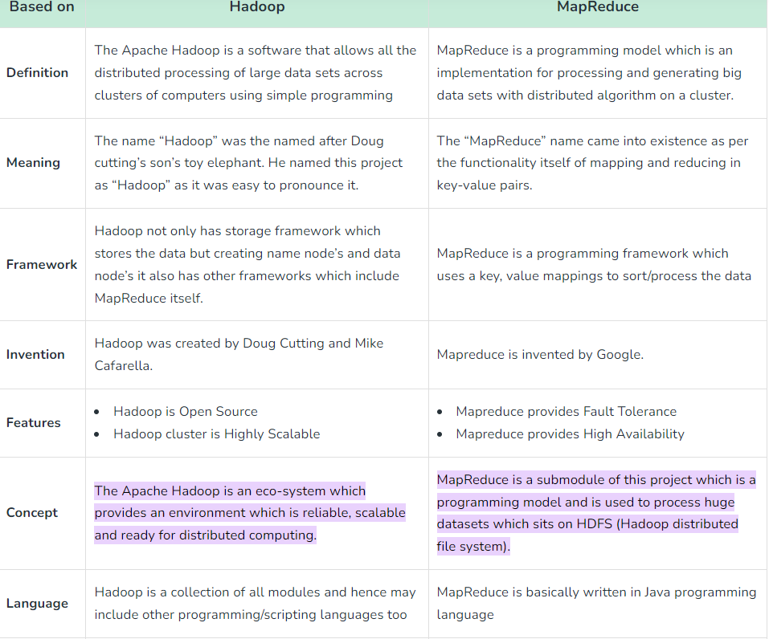

Slide 36
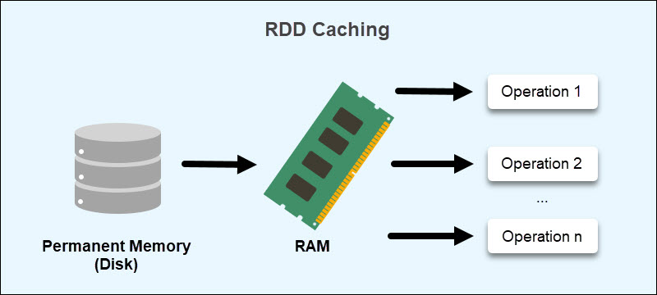
Why Do We Need RDDs in Spark?
RDDs address MapReduce's shortcomings in data sharing. When reusing data for computations, MapReduce requires writing to external storage (HDFS, Cassandra, HBase, etc.). The read and write processes between jobs consume a significant amount of memory.
Furthermore, data sharing between tasks is slow due to replication, serialization, and increased disk usage.

Slide 37
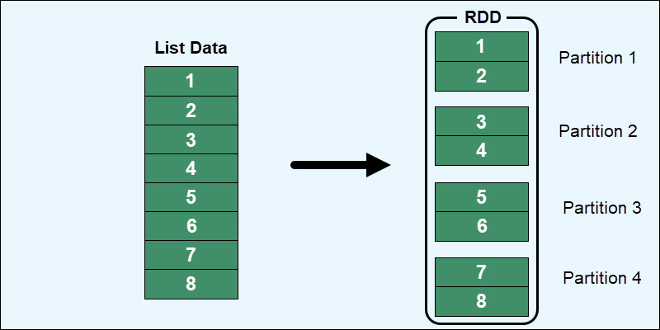
RDDs aim to reduce the usage of external storage systems by leveraging in-memory compute operation storage. This approach improves data exchange speeds between tasks by 10 to 100 times.
Speed is critical when working with large data volumes. Spark RDDs make it easier to train machine learning algorithms and handle large amounts of data for analytic
How Does RDD Store Data?

Slide 38
The disadvantages when working with Resilient Distributed Datasets include:
No schematic view of data. RDDs have a hard time dealing with structured data. A better option for handling structured data is through the DataFrames and Datasets APIs, which fully integrate with RDDs in Spark.
Garbage collection. Since RDDs are in-memory objects, they rely heavily on Java's memory management and serialization. This causes performance limitations as data grows.
Overflow issues. When RDDs run out of RAM, the information resides on a disk, requiring additional RAM and disk space to overcome overflow issues.
No automated optimization. An RDD does not have functions for automatic input optimization. While other Spark objects, such as DataFrames and Datasets, use the Catalyst optimizer, for RDDs, optimization happens manually.

Slide 39
Spark consists of the following core components
Spark Core: An execution engine and the heart of Spark, which forms the basis for all other components. It manages task dispatching, I/O operations, and task scheduling.
Spark SQL: Built on top of Spark core, Spark SQL performs distributed processing on data. It provides access to various data sources — HDFS, Hive, etc.
Spark Streaming: A library to process streaming data. It can stream gigabytes per second. It splits data into mini-batches and transforms them into RDDs.
MLlib: A machine learning containing different ML algorithms.
GraphX: A distributed graph-processing framework.
What is the difference between persist and cache table in Spark?
CACHE and PERSIST do the same job to help in retrieving intermediate data used for computation quickly by storing it in memory, while by caching we can store intermediate data used for calculation only in memory , persist additionally offers caching with more options/flexibility

Slide 40
3. Apache Hive
Hive is an open-source distributed data warehouse system built on top of Apache Hadoop. It supports reading, writing, and analyzing petabytes of data stored in distributed storage. We get an SQL-like interface called HiveQL to query data stored in databases and file systems that integrate with Hadoop.
Traditional databases can only process small to medium volumes of data. On the other hand, Hive leverages batch processing, like Hadoop, to process data quickly across a distributed database.
4.Apache Storm
Storm is a free and open-source real-time distributed big data processing system. It makes it easy to process unbounded streams of data. It processes data in a fault-tolerant and horizontally-scalable way. While simple to use, Storm is compatible with any programming language.
5. Apache Samza
It is a distributed stream processing framework, allowing users to build real-time applications that can process data.

Slide 41
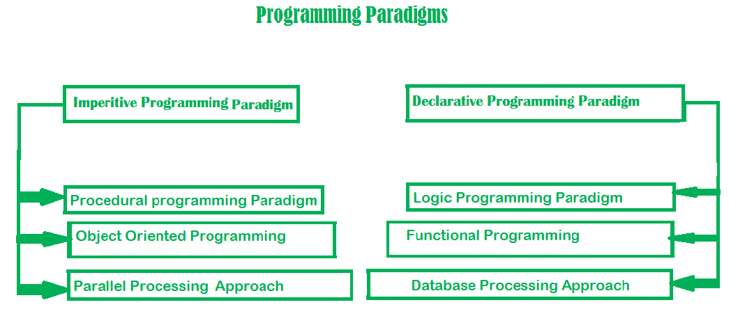
Big Data Programming Paradigms

Slide 43
Imperative programming paradigm: It is one of the oldest programming paradigm. It features close relation to machine architecture. It is based on Von Neumann architecture. It works by changing the program state through assignment statements. It performs step by step task by changing state. The main focus is on how to achieve the goal. The paradigm consist of several statements and after execution of all the result is stored.
Advantages:
Very simple to implement
It contains loops, variables etc.
Disadvantage:
Complex problem cannot be solved
Less efficient and less productive
Parallel programming is not possible
Examples of Imperative programming paradigm:
C : developed by Dennis Ritchie and Ken Thompson
Fortran : developed by John Backus for IBM
Basic : developed by John G Kemeny and Thomas E Kurtz
2. Procedural programming paradigm –
This paradigm emphasizes on procedure in terms of under lying machine model. There is no difference in between procedural and imperative approach. It has the ability to reuse the code and it was boon at that time when it was in use because of its reusability.
Examples of Procedural programming paradigm:
C : developed by Dennis Ritchie and Ken Thompson
C++ : developed by Bjarne Stroustrup
Java : developed by James Gosling at Sun Microsystems
ColdFusion : developed by J J Allaire
Pascal : developed by Niklaus Wirth
3. Object oriented programming –
The program is written as a collection of classes and object which are meant for communication. The smallest and basic entity is object and all kind of computation is performed on the objects only. More emphasis is on data rather procedure. It can handle almost all kind of real life problems which are today in scenario.
Advantages:
Data security
Inheritance
Code reusability
Flexible and abstraction is also present

Slide 44
Examples of Object Oriented programming paradigm:
Simula : first OOP language
Java : developed by James Gosling at Sun Microsystems
C++ : developed by Bjarne Stroustrup
Objective-C : designed by Brad Cox
Visual Basic .NET : developed by Microsoft
Python : developed by Guido van Rossum
Ruby : developed by Yukihiro Matsumoto
Smalltalk : developed by Alan Kay, Dan Ingalls, Adele Goldberg
Parallel processing approach –
Parallel processing is the processing of program instructions by dividing them among multiple processors. A parallel processing system posses many numbers of processor with the objective of running a program in less time by dividing them. This approach seems to be like divide and conquer. Examples are NESL (one of the oldest one) and C/C++ also supports because of some library function.
2. Declarative programming paradigm:
It is divided as Logic, Functional, Database. In computer science the declarative programming is a style of building programs that expresses logic of computation without talking about its control flow. It often considers programs as theories of some logic.It may simplify writing parallel programs. The focus is on what needs to be done rather how it should be done basically emphasize on what code is actually doing. It just declares the result we want rather how it has be produced. This is the only difference between imperative (how to do) and declarative (what to do) programming paradigms. Getting into deeper we would see logic, functional and database.

Slide 45
Logic programming paradigms –
It can be termed as abstract model of computation. It would solve logical problems like puzzles, series etc. In logic programming we have a knowledge base which we know before and along with the question and knowledge base which is given to machine, it produces result. In normal programming languages, such concept of knowledge base is not available but while using the concept of artificial intelligence, machine learning we have some models like Perception model which is using the same mechanism.
In logical programming the main emphasize is on knowledge base and the problem. The execution of the program is very much like proof of mathematical statement, e.g., Prolog
predicates
sumoftwonumber(integer, integer).
clauses
sumoftwonumber(0, 0).
sumoftwonumber(N, R) :-
N > 0,
N1 is N - 1,
sumoftwonumber(N1, R1),
R is R1 + N.
Functional programming paradigms –
The functional programming paradigms has its roots in mathematics and it is language independent. The key principle of this paradigms is the execution of series of mathematical functions. The central model for the abstraction is the function which are meant for some specific computation and not the data structure. Data are loosely coupled to functions.The function hide their implementation. Function can be replaced with their values without changing the meaning of the program. Some of the languages like perl, javascript mostly uses this paradigm.
Examples of Functional programming paradigm:
JavaScript : developed by Brendan Eich
Haskell : developed by Lennart Augustsson, Dave Barton
Scala : developed by Martin Odersky
Erlang : developed by Joe Armstrong, Robert Virding
Lisp : developed by John Mccarthy
ML : developed by Robin Milner
Clojure : developed by Rich Hickey

Slide 46
Database/Data driven programming approach –
This programming methodology is based on data and its movement. Program statements are defined by data rather than hard-coding a series of steps. A database program is the heart of a business information system and provides file creation, data entry, update, query and reporting functions. There are several programming languages that are developed mostly for database application. For example SQL. It is applied to streams of structured data, for filtering, transforming, aggregating (such as computing statistics), or calling other programs. So it has its own wide application.
Big Data Programming Languages
Big Data Programming Languages
1. Python
Python is a general-purpose programming language that programmers use when integrating data analysis with web applications. Data scientists and technical analysts prefer using this open-source programming language because it offers them multiple data manipulation and plotting libraries, such as Pandas and Matplotlib. Data visualisation and machine learning become easy with Python, as it can support varied analyses and integrate with third-party packages. This high-level programming language may also work as a programming interface for an analytics system.
2. R
R is an open-source programming language that users utilise to work with graphics data visualisation and statistics. There is a wide range of graphical tools in R, along with open-source packages that help users visualise, model, manipulate and load data. Its robust environment allows a technical analyst to perform several types of data analyses. This programming language is highly flexible, as a user can run it on almost all operating systems.

Slide 47
3. Scala
Scala, also referred to as scalable language, is an efficient programming language for processing data quickly. It supports both functional programming and object-oriented programming (OOP), so it becomes easy for users to utilise languages based on these programming models. Several front-end developers prefer using Scala, as it combines compact syntax with impressive development tools. Fintech companies also utilise Scala to work with data architectures and cloud-based technologies. Scala has several features that a user can employ to write algorithms for machine learning and devise solutions for complex analytics.
4. Java
Programmers use Java to write production code that enables them to use big-data algorithms. Java for big data is helpful when programmers are implementing a theoretical model that they have created in Python. Big-data analysis is easy with Java, as it helps data scientists to process big data, manage higher prediction load and resize intricate ecosystems. Java also works as the base for many big-data tools, such as Spark, Storm or Mahout. Java is the foundation of Scala's Apache Spark library, so knowing how to work with it may also help users to write in Scala comfortably.
5. SQL
SQL stands for Structured Query Language, which is useful when working with complex datasets outside a relational-database environment. With SQL, a user can perform various operations, such as modifying tables and updating or removing records. It can help a data scientist to work with structured data. There are big-data platforms, such as Spark and Hadoop, that offer extension for querying using this domain-specific language. SQL is an effective tool with which data scientists can wrangle and prepare data, so they use the language when working with different big-data tools.

Slide 48
6. C++
When technical experts are working with complex machine-learning algorithms, they may often process data sets in terabytes and petabytes. To complete such tasks quickly, they may use C++, as this platform can process data in gigabytes in just a few seconds. Conducting predictive analytics in real time and keeping records consistent are some other benefits of using C++. A data scientist may use the programming language to code libraries and big-data frameworks. There are many deep-learning algorithms and neural networks that data scientists can write in C++.
7. Go
Go, also referred to as Golang, is an open-source programming language that helps developers build simple and efficient software tools. Its presence is usually evident in DevOps and web servers, but it is also a useful language for businesses that make data-driven decisions. A business can use Go to integrate computationally exhaustive algorithms with all its levels of organisational structure. With Go, pre-processing, transforming, analysing, modelling and validating become easy. This language allows users to write controllers for events that occur asynchronously.
8. Julia
Julia's performance is comparable to C++, which means it is fast, reliable and efficient. It is a programming language that offers robust statistical applicability and an interactive command line. C, R, Java and Python form the basis for many of its libraries. These libraries help data scientists to perform artificial intelligence development with ease. Doing high-level statistical work on this platform is unchallenging. It also outperforms some other languages when working with linear algebra, as it supports several machine-learning equations and matrixes.

Slide 49
Introduction to Data Science
Data Science is about data gathering, analysis and decision-making.
Data Science is about finding patterns in data, through analysis, and make future predictions.
By using Data Science, companies are able to make:
Better decisions (should we choose A or B)
Predictive analysis (what will happen next?)
Pattern discoveries (find pattern, or maybe hidden information in the data)
Where is Data Science Needed?
Data Science is used in many industries in the world today, e.g. banking, consultancy, healthcare, and manufacturing.
Examples of where Data Science is needed:
For route planning: To discover the best routes to ship
To foresee delays for flight/ship/train etc. (through predictive analysis)
To create promotional offers
To find the best suited time to deliver goods
To forecast the next years revenue for a company
To analyze health benefit of training
To predict who will win elections

Slide 50
Data Science can be applied in nearly every part of a business where data is available. Examples are:
Consumer goods
Stock markets
Industry
Politics
Logistic companies
E-commerce
How Does a Data Scientist Work?
A Data Scientist requires expertise in several backgrounds:
Machine Learning
Statistics
Programming (Python or R)
Mathematics
Databases

Slide 51
A Data Scientist must find patterns within the data. Before he/she can find the patterns, he/she must organize the data in a standard format.
Here is how a Data Scientist works:
Ask the right questions - To understand the business problem.
Explore and collect data - From database, web logs, customer feedback, etc.
Extract the data - Transform the data to a standardized format.
Clean the data - Remove erroneous values from the data.
Find and replace missing values - Check for missing values and replace them with a suitable value (e.g. an average value).
Normalize data - Scale the values in a practical range (e.g. 140 cm is smaller than 1,8 m.
However, the number 140 is larger than 1,8. - so scaling is important).
Analyze data, find patterns and make future predictions.
Represent the result - Present the result with useful insights in a way the "company" can understand.

Slide 54
Skills for Big Data Jobs
1. SQL
SQL is one of the most important skills that must have. While using SQL, a programmer can have an advantage in working with multiple technologies (such as NoSQL).
SQL is the data-centered language that works as a base for the big data era.
Programmers use SQL for multiple operations such as adding, updating, deleting, or modifying any records or tables, and so on. Besides this, RDBM or Relational database management is a crucial part of the field of data science and a data scientist can only control, manipulate or define and query the DB using SQL commands.
Today, some of the modern big data systems (such as Hadoop and Spark) also use SQL only for maintaining the RDBMS (relational database systems) and processing structured data.
2. Apache Spark
Spark was first introduced by UC Berkeley in 2009 and since then it started gaining popularity in the field of data science. Today, Spark is capable enough to handle data (up to Petabytes) at a time and its data distribution happens across thousands of cluster cooperating servers (both physical and virtual). Spark also comes with an extensive range of libraries (and APIs) that can be commonly used by multiple programming languages (such as R, Scala, and Python).
Besides this, Apache uses Hadoop Distributed File System (HDFS) but can be integrated equally with other data storage systems. Developers prefer Spark often because it enables overlapping the complex technologies (such as MapReduce) and that’s why it is widely being used by data scientists and has been highly adopted by major organizations. People holding such skills possess to bag more lucrative packages than others.
3. ML/AI/DL
Machine Learning, Artificial Intelligence, and Deep Learning are three hot fields of big data. Although the path is way beyond them they are the ones making a significant impact on the field.
Whether it’s your smartphone, car, laptop, home devices, etc. they all are now highly equipped with artificial intelligence that we’re using on daily basis. Whenever you pick your phone up and say aloud “Hey Siri”, it’s likely that you’re using these technologies. The point is, that AI, ML, and DL are everywhere in our surroundings today and data science is the interdisciplinary field of getting that knowledge as per requirement. These technologies are making a huge impact in our day-to-day lives and helping us in making a better future.
That’s why the professionals with the knowledge of machine learning, artificial intelligence, and deep learning are in huge demand irrespective of the business scale (from small to large) and the average payscale of entry-level professionals are somewhere around $110,100 per annum and makes to one of the most handsome jobs in the world.

Slide 55
4. Apache Hadoop
When it comes to handling any huge cluster of data, Hadoop is the answer all the time. Being one of the most popular big data platforms, it’s widely used for data operations that involve large-scale (unstructured) data. If you want to make your career in big data, we must understand the importance and knowledge of handling data on large scale.
Hadoop was first introduced by Doug Cutting and Mike Cafarella in 2005 and became public in late 2012. Ever since many implementations and development have been made. In today’s time, some of the most popular components that are widely used in Hadoop are Hive, Pig, HDFS, MapReduce, etc.
5. Programming Language
This is something that creates the base of your big data career and there are certain general-purpose programming languages that enables you to work in this field smoothly. Languages like Python, R, Java, C++, SQL, Scala, Julia, etc. are some of the most widely used languages and that can also remove the learning barricade from becoming a successful data analyst expert.
Top companies prefer to hire those candidates who possess knowledge of these programming languages. You need to learn Python, Java, or R programming language (at least for your initial career) and that’s where you will be able to start working on some of the most useful tools for data visualization, extraction, scraping, etc.
6. Data Visualization
Enabling the capabilities of displaying data visually is slightly more impactful than traditional methods. It helps people understand the latest trends, and patterns and help them in deciding the outcome (in many cases). That’s why data visualization is among the top skill sets that you must possess to get on board in the big data field.
Companies are willing to pay much lucrative salaries to those who possess the knowledge of the best data visualization tools such as QlikView, Tableau, etc. Hence, to give your career a headstart, it is important to know what Big Data skills you need to break into analytics and start working with data.
7. Statistical Analysis
It’s an important method of data analysis that helps in drawing meaningful outputs from any unstructured data. This method also helps in making fruitful business decisions based on data trends.
It can also be defined as a science of collecting and analyzing data to trace patterns and trends by involving numbers used in businesses. Being a data analyst will require you to possess this skill because it’s all about data now and companies look forward to those candidates that carry such skills. Some of the most important tools for statistical analysis are MATLAB, R, SAS, etc.

